Slide 1

EV Charging Demand Prediction
Machine Learning Project
Presented by: Deepika B
GUVI ML Project
Project Objective:
EV Charging Demand Prediction is a machine learning project designed to predict electric vehicle charging demand based on charging session characteristics, time-related factors, location, and charger information. The project includes data cleaning, exploratory data analysis, feature engineering, regression model comparison, model evaluation, feature-importance analysis, model serialization using pickle, and deployment through an interactive Streamlit dashboard.

Slide 2
Dataset Description:
Column | Description
UserID | Unique identifier for the user
ChargerID | Identifier for the charging station/charger
ChargerCompany | Charger company identifier
Location | Charging location type
ChargerType | Charger type identifier
StartDay | Charging session start day
StartTime | Charging session start time
EndDay | Charging session end day
EndTime | Charging session end time
StartDatetime | Charging session start timestamp
EndDatetime | Charging session end timestamp
Duration | Original recorded charging duration
Demand | Target variable representing charging demand

Slide 3
3. Data Cleaning
The dataset was checked and cleaned to ensure data quality before performing analysis and model training.
Cleaning steps performed
Converted StartDatetime and EndDatetime into datetime format.
Identified and removed 17 records with invalid timestamps, where the end time occurred before the start time.
Calculated charging duration from the start and end timestamps.
Compared the original Duration with the calculated duration and identified inconsistencies.
Removed 13 exact duplicate records.
Checked for missing values; no missing values were present in the final dataset.
 | Records
Original dataset | 72,856
Invalid records removed | 17
Duplicate records removed | 13
Final cleaned dataset | 72,826
Final Dataset
The cleaned dataset was saved as ev_charging_cleaned.csv and used for further analysis and machine learning.

Slide 4
4. Exploratory Data Analysis (EDA)
EDA was performed to understand the major patterns and relationships in EV charging demand.
Key Findings
Demand Distribution: Demand was right-skewed, with values ranging from 0.01 to 97.
Charging Duration: Calculated_Duration showed a moderate positive relationship with Demand, with a correlation of approximately 0.604.
Time of Day: Demand varied significantly across different hours. Higher demand was observed during late-night/early-morning hours and again during the evening.
Day of Week: Demand remained relatively stable across different days of the week.
Charger Type: Different charger types showed differences in their average demand.
Charger Company: Average demand varied between the two charger companies.
Location: Demand varied across charging locations, with some smaller location categories showing higher average demand.
EDA Conclusion
The analysis indicated that charging duration, time-related factors, charger characteristics, and location are useful variables for predicting EV charging demand. These findings were used to guide the feature engineering and machine learning stages.

Slide 5
5. Feature Engineering
Feature engineering was performed to extract useful information from the existing dataset and prepare it for machine learning.
Features Created
From the StartDatetime column, the following time-based features were extracted:
Hour – hour of the charging session
Day – day of the month
Month – month of the year
DayOfWeek – day of the week
Quarter – quarter of the year
IsWeekend – identifies whether the session occurred on a weekend
TimeOfDay – categorizes the session into Night, Morning, Afternoon, or Evening
Additional features used in the model included:
Location
ChargerType
ChargerCompany
Calculated_Duration

Slide 6
Categorical Encoding
Categorical features such as Location and TimeOfDay were converted into numerical form using One-Hot Encoding so that they could be used by the machine learning models.
Modeling Scenarios
Two feature scenarios were created to evaluate the importance of charging session duration:
Model A: Used time, location, and charger-related features without Calculated_Duration.
Model B: Included all Model A features plus Calculated_Duration.
This comparison helped determine how much predictive improvement was obtained when charging session duration was included.
6. Model Building and Comparison
The cleaned and feature-engineered dataset was used to build REGRESSION MODELS for predicting EV charging demand.
Models Evaluated
Six regression algorithms were trained and compared:
Linear Regression
Decision Tree Regressor
Random Forest Regressor
Gradient Boosting Regressor
XGBoost Regressor
LightGBM Regressor

Slide 7
Two feature scenarios were evaluated for each model:
Model A: Without Calculated_Duration
Model B: With Calculated_Duration
Evaluation Metrics
The models were evaluated using:
MAE (Mean Absolute Error) – measures the average absolute prediction error.
MSE (Mean Squared Error) – gives greater weight to larger errors.
RMSE (Root Mean Squared Error) – measures prediction error in the same unit as the target.
R² Score – indicates how well the model explains the variation in charging demand.

Slide 8
Model Comparison
The best results from Model B were:
Model Selection
LightGBM Regressor was selected as the final model because it achieved the best RMSE (6.10) and R² score (0.794) among the evaluated models.
Although XGBoost achieved a slightly lower MAE, LightGBM provided the best overall performance based on RMSE and R².
Model | MAE | RMSE | R²
Linear Regression | 6.26 | 10.04 | 0.440
Decision Tree | 4.45 | 8.60 | 0.590
Random Forest | 3.51 | 6.23 | 0.784
Gradient Boosting | 3.78 | 6.49 | 0.766
XGBoost | 3.45 | 6.11 | 0.793
LightGBM | 3.49 | 6.10 | 0.794

Slide 9
7. Key Findings
The major findings from the EV Charging Demand Prediction project are:
Charging demand showed a clear time-of-day pattern, with demand varying significantly across different hours.
Calculated_Duration showed a moderate positive relationship with Demand (correlation ≈ 0.604).
Demand varied across different locations, charger types, and charger companies.
Including Calculated_Duration significantly improved model performance compared with the scenario without it.
Among the six regression models evaluated, XGBoost and LightGBM performed the best, with very similar results.
LightGBM was selected as the final model, achieving an RMSE of 6.10 and R² of 0.794.
Feature importance analysis identified Calculated_Duration, Month, Hour, and Day among the most influential features.
The final LightGBM model was serialized using Pickle and integrated into the Streamlit dashboard for interactive demand prediction.

Slide 10
Classification – High Demand Prediction
Objective
Classify each EV charging session as High Demand or Normal Demand.
Target Definition
Median Demand = 14.1
High Demand: Demand ≥ 14.1
Normal Demand: Demand < 14.1
Classes were almost perfectly balanced (50.04% vs 49.96%), so no oversampling/SMOTE was required.
Model | Accuracy | F1-score | ROC-AUC
Logistic Regression | 82.63% | 83.10% | 89.97%
Decision Tree | 84.77% | 84.78% | 84.79%
Random Forest | 89.37% | 89.74% | 95.16%
KNN | 79.92% | 80.21% | 87.64%
Linear SVM | 82.67% | 83.94% | 89.55%
XGBoost | 89.65% | 90.03% | 95.72%
LightGBM | 89.45% | 89.88% | 95.64%

Slide 11
Models Compared
Logistic Regression | Decision Tree | Random Forest | KNN | SVM | XGBoost | LightGBM
Best Model – XGBoost
Accuracy: 89.65%
Precision: 86.96%
Recall: 93.32%
F1-Score: 90.03%
ROC-AUC: 95.72%
Key Finding
ChargerType was the most important predictive factor, followed by Calculated_Duration and ChargerCompany.
Model Deployment
The final XGBoost classification pipeline was serialized using Pickle for later integration into the Streamlit dashboard.
FINAL MODEL SELECTION
Task | Final Model/Method | Key Result
Regression | LightGBM | R² = 0.794, RMSE = 6.10
Classification | XGBoost | Accuracy = 89.65%, ROC-AUC = 95.72%

Slide 12
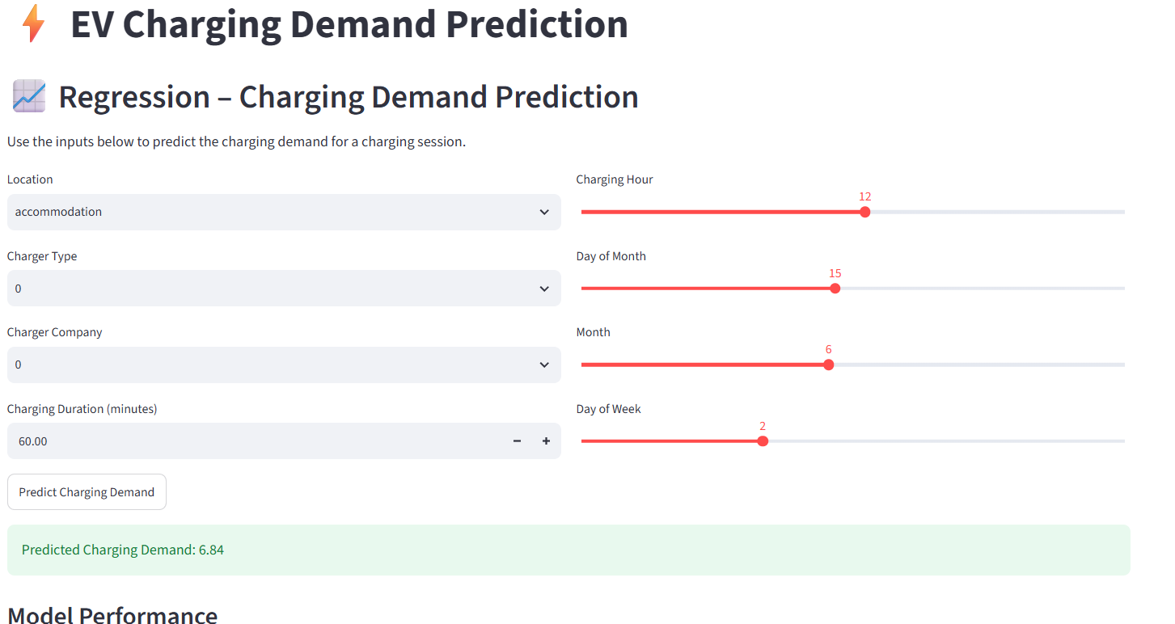
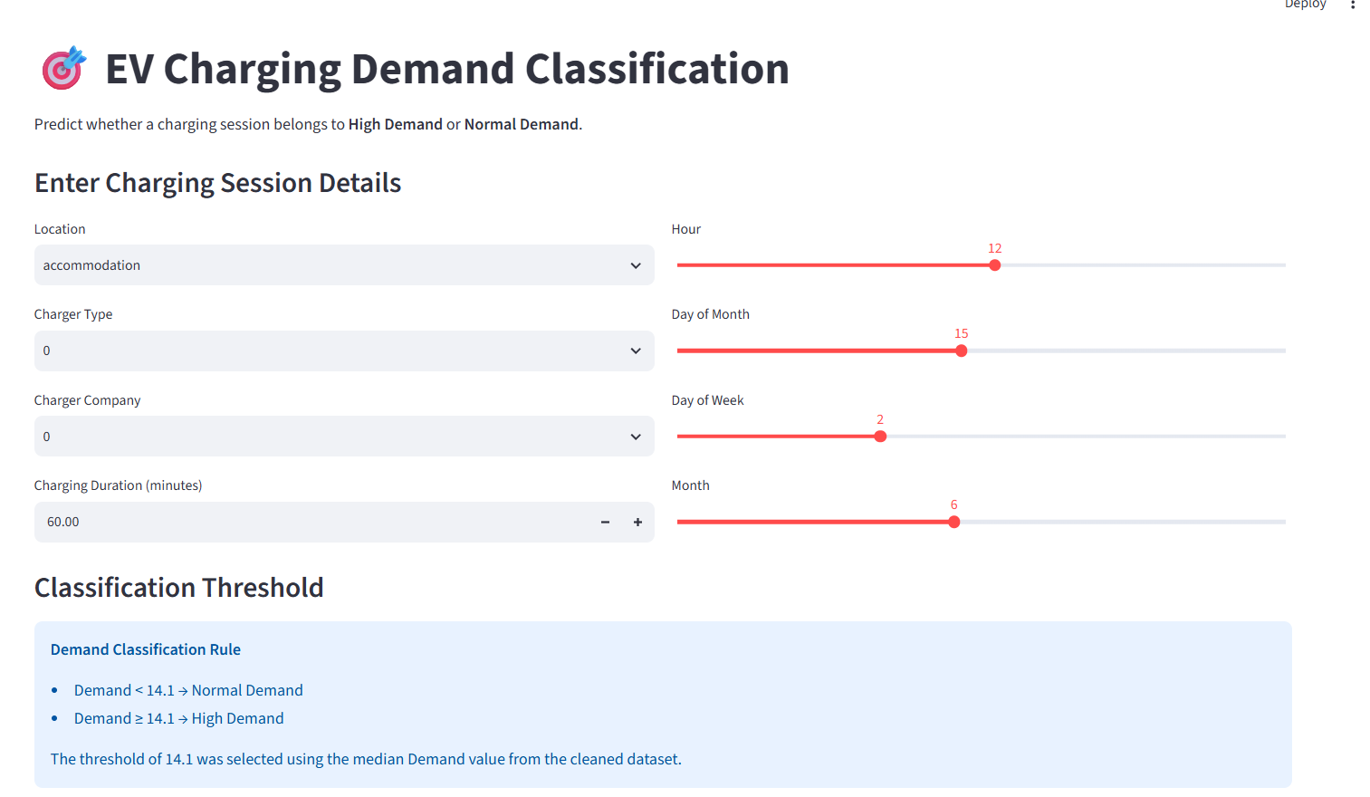
STREAMLIT DAHBOARD & DEPLOYMENT
Regression
LightGBM prediction
Classification
XGBoost prediction
The Streamlit dashboard integrates the trained and serialized machine learning models to provide interactive demand predictions, classification results, model performance comparisons, feature importance, SHAP explanations.

